Slide 1
This work is licensed under the Creative Commons Attribution 4.0 International License. To view a copy of this license, visit http://creativecommons.org/licenses/by/4.0/ or send a letter to Creative Commons, PO Box 1866, Mountain View, CA 94042, USA.
Copyright (c) 2022 Cisco Systems, Inc. and its affiliates
All rights reserved.

Slide 2





[Insert Survey QR code]
OR
[Insert Survey URL code and Passcode]
What does a safe environment mean for you?

Slide 3

Session 2: Designing a Team Where Everyone Feels Safe
Full Stack Wellness & Inclusion Series

Slide 4





Session 2: Safety
What (are we going to deliver)?
Designing a team where everyone feels safe
Discuss microaggressions and the impact they have on our work environment. We will also discuss creating safe environments and how they can help to make your teams and collaboration stronger
Why (is this session important)?
Self Actualization
Needs
Esteem Needs
Love/Belonging Needs
Physiological Needs
Safety Needs
To highlight the consequences of an unsafe work environment and benefits of a safe environment where employees can thrive.
Story
A member shares a story about experiencing a microaggression (conscious and unconscious) and how they addressed it
Who (are we going to invite)?
<insert appropriate company within your organization>
Post-event Activity
Share stories of microaggression in different workplaces to spread awareness + change something about your own behavior + demo role playing)
[This image is borrowed from Maslow's hierarchy of needs]

Slide 5




Agenda
Intro
Welcome Back
Guest Speaker Story
"Let’s Talk about Well-being & Psychological Safety"
{<Your Organization Story>
Let’s talk!
<Inclusive Language Topic>
Our post-event activity
Call to Action- Inter-faith Prayer Walk
Safety & Well-being Resources
Visit the Diversity and Inclusion SharePoint Page

Slide 6
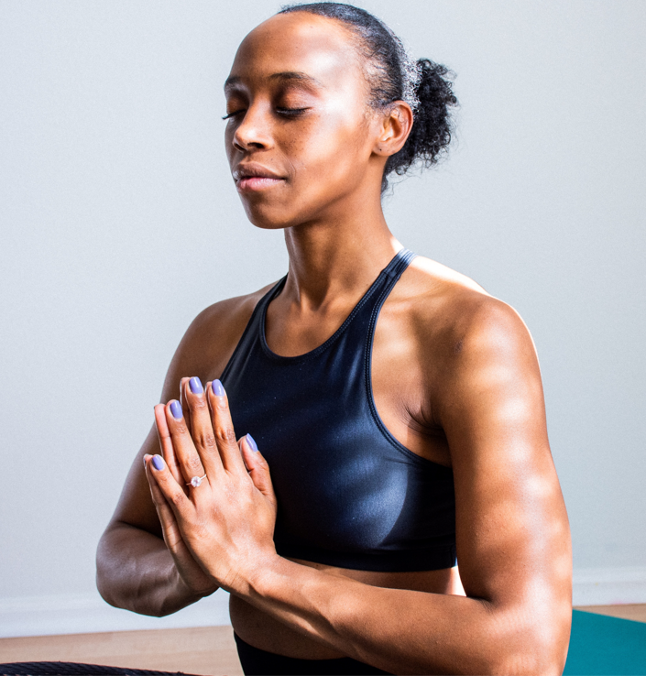
Let's Talk
Well-Being
A Discussion Regarding Psychological Safety

Slide 7
Agenda
What is Psychological Safety
A simple definition we all can understand
What Does It Feel Like
Understanding what it feels like
Understanding what it should not feel like
Characteristics of a Safe Team
Ways to Promote Safety
Ways to address and promote safety
Q&A
Let’s Get Your Questions Answered

Slide 8
Psychological Safety
The belief that your environment is safe for interpersonal risk-taking.

Slide 9
What Psychological Safety Feels Like
What It Feels Like
Freedom to share new ideas or new things, even if they aren’t “perfect”
Energized or motivating
Safe
Constructive feedback is provided on ideas
The benefit of the doubt is default
Freedom to express yourself even if you make a mistake
What it Does Not Feel Like
Feeling the need to make things perfect before sharing
Exhausting or draining
Guarded
Ideas or actions are criticized
Assumptions prevent conversation
Embarrassed or ridiculed for making a mistake or speak up

Slide 10
Characteristics of a Psychological Safe Team
Mutual Respect
Trust and Interest in each other as people
Equality in conversational turn-taking
Shared humility and unconditional professional respect for others
A safe-space for individuals to make mistakes
Team members do not attack each other's knowledge, personality, or character

Slide 11
Ways to Address Psychological Safety
Be vulnerable, while also allowing space for others to be vulnerable
Create an environment of trust
Encourage equal speaking time
Be conscious of your verbal and non-verbal communication
Recognize your shared humanity and show professional respect
Give others space to make mistakes

Slide 12
Ways to Promote Psychological Safety
Promote Self-Awareness
Demonstrate Concerns for Team Members as People
Actively Solicit Questions
Provide Multiple Ways for Employees to Share Their Thoughts
Show Value and Appreciation for Ideas
Promote Positive Dialogue and Discussion
Be Precise with Information, Expectations, and Commitments
Explain Reasons for Change
Own Your Mistakes
Source: https://www.quantumworkplace.com/future-of-work/create-psychological-safety-in-the-workplace

Slide 13
Conversation with Presenter & Share Story
What are some other things that we can do to support our colleagues as it relates to psychological safety?

Slide 14

Conversation with [Speaker]
Question:
Which behaviors make people feel safe and included?

Slide 15
Conversation with [Speaker]
Question:
What's a simple technique to help people get a turn in meetings?

Slide 16
Conversation with [Speaker]
Question:
What methods do you use to actively solicit questions live and offline?

Slide 17
Ensuring and supporting Safety

Slide 18
Ensuring and supporting safety at [Company]
[Insert available Resources from the benefits page]

Slide 19
[Insert Survey QR code]
OR
[Insert Survey URL code and Passcode]
What are one or two words you will carry with you from this session?

Slide 20
[Topic to highlight changes for Inclusive Language in Technology ]

Slide 21

Creating a team where everyone thrives
Bi-Weekly Stand Up:
Check-in Activity
<date>
Bi-Weekly Stand Up:
Check-in Activity
<date>
Bi-Weekly Stand Up:
Check-in Activity
<date>
Bi-Weekly Stand Up:
Check-in Activity
<date>
TBC…
Session 1: Your Physical Layer: Healthy Body, Healthy Mind
Session 2: Designing a Team Where Everyone Feels Safe
Session 3: Developing a Team Where Everyone Belongs
Session 4: Personal Code Reviews: Owning and Honoring our Achievements
Session 5: CI/CD Pipeline for Your Best Self
Kick Off Session: Full Stack Wellness & Inclusion
Today
Today + 1 month
Today + 2 months
Today + 3 months
Today + 4 months

